Slide 1

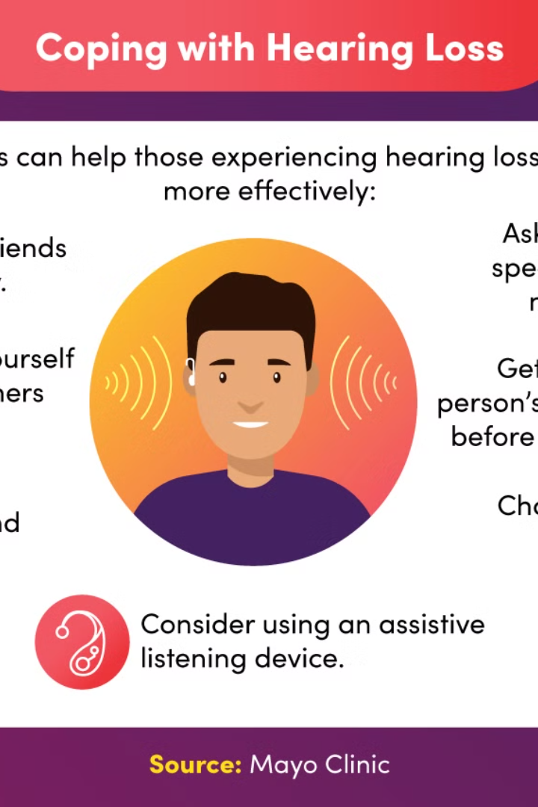
Understanding Hearing Problems
Hearing problems can significantly impact daily life. Patients may struggle to hear conversations, music, and other important sounds.

Slide 2


Common Causes of Hearing Loss
1
Age-related
2
Noise Exposure
Hearing loss is common as people age due to changes in the inner ear.
Regular exposure to loud noises can cause irreversible damage to the ears.
3
Genetic Factors
Heredity can play a major role in determining susceptibility to hearing loss.

Slide 3
Importance of Early Detection
Prevent Further Damage
Improved Treatment Options
Enhanced Quality of Life
Early interventions can significantly improve the quality of life for individuals with hearing problems.
Identifying issues early can prevent worsening of hearing loss.
Early detection allows for more treatment options with higher success rates.

Slide 4
Technology Solutions for Hearing Problems
Hearing Aids
Cochlear Implants
Hearing aids amplify sounds to make them clearer and easier to understand.
Cochlear implants directly stimulate the auditory nerve to provide sound signals to the brain.

Slide 5
Hearing Aids and Their Features
Directional Microphones
Noise Reduction
Rechargeable Batteries
Telecoil
Bluetooth Connectivity
Customizable Programs

Slide 6
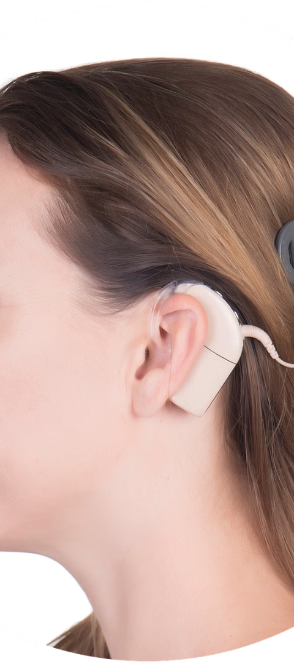


Cochlear Implants and Their Benefits
Improved Speech Recognition
Cochlear implants can significantly enhance one's ability to understand speech.
Higher Sound Quality
Implants offer clearer and more natural sound compared to traditional hearing aids.

Slide 7



Assistive Listening Devices
Personal Amplifiers
Captioning Devices
Hearing Loop Systems
Amplify sounds in challenging listening environments.
Display text of spoken words in real-time.
Transmit audio wirelessly to hearing aids or cochlear implants.

Slide 8
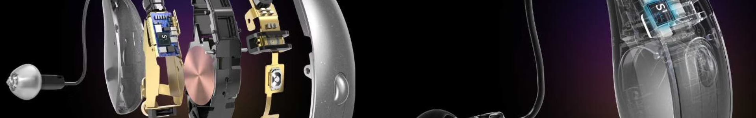
Future Advancements in Hearing Technology
Nanotechnology
1
Advancements in nanotech could lead to more effective and compact hearing devices.
2
Biometric Integration
Future devices may integrate biometrics for a truly customized hearing experience.
Artificial Intelligence
3
AI could enhance sound processing and adaptability for various listening environments.

